Slide 1



Personal Brand Accelerator
Lesson 1: Why Great Work Isn’t Enough

Slide 2
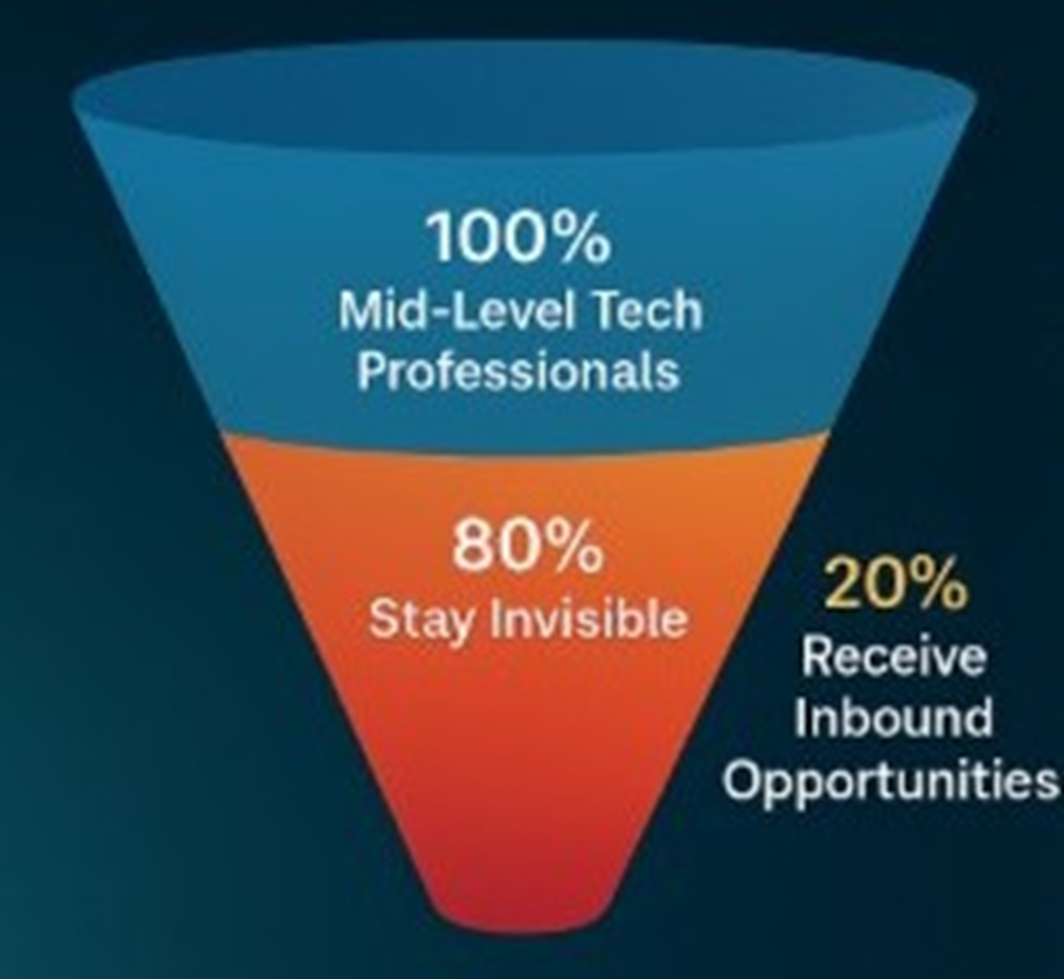
Visibility > Talent: The Hidden Truth in Tech Careers
personal branding
Notes:
“Let’s start with a hard truth — more than 80% of mid-level tech professionals never receive inbound job opportunities. Not because they lack skills, but because they’re invisible. In a digital-first world, opportunities don’t go to the most talented — they go to the most visible. Think about that for a moment. You can be exceptional, but if no one can find or recognize that excellence, it might as well not exist.”

Slide 3
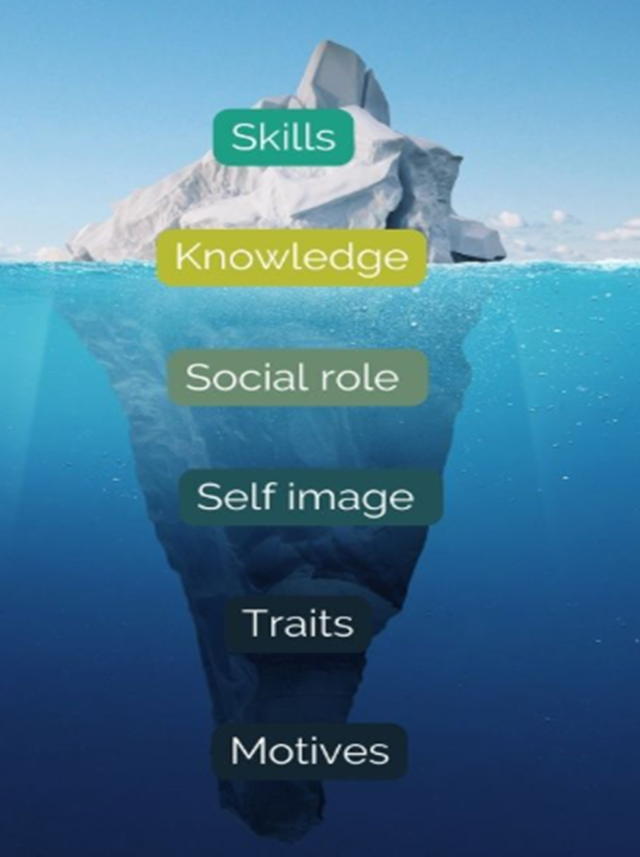
Competence Iceberg Model
Career Impact =
(Competence x Visibility) + Consistency
personal branding
Notes:
“For years, we were told: ‘Work hard, stay humble, and your work will speak for itself.’ But the truth is, your work has no voice unless you give it one. Competence is your foundation — it’s what you can do. But visibility is what allows people to see it. And consistency is what allows them to believe it. When these three come together, you become discoverable — and that’s the starting point for career momentum.”
Even if your competence is a 10 out of 10, if your visibility is a zero – your impact is zero. On the other hand, moderate skill, paired with high visibility and steady consistency, creates recognition, trust, and opportunity. This is why personal branding isn’t vanity – it’s strategy. Career Impact = (Competence x Visibility) + Consistency

Slide 4

The Visibility Equation
Career Impact = (Competence x Visibility) + Consistency
personal branding
Notes:
“Let’s break this down into a simple framework: Career Impact = (Competence × Visibility) + Consistency.
Competence - Skill, expertise, and ability to deliver results.
Visibility – How well others know, recognize, and trust your capabilities.
Consistency- Steady actions that build credibility over time.
Even if your competence is a 10 out of 10, if your visibility is a zero — your impact is zero. On the other hand, moderate skill, paired with high visibility and steady consistency, creates recognition, trust, and opportunity. This is why personal branding isn’t vanity — it’s strategy.”
Visibility turns potential into opportunity – one consistent cation at at time.

Slide 5


Brilliant IT architect, but behind the scenes
Shares insights on LinkedIn monthly
No posts, no talks, no visibility
Builds cross-functional reputation
Missed promotions & recognition
Leads internal talks on system design and now is a speaker at cloud conference
Excellent — but invisible
(Competence = 10 | Visibility = 2
Now, he’s not just skilled — he’s seen
(Competence = 10 | Visibility = 8 | Consistency = strong
The Story of Arjun
personal branding
Notes:
“Arjun was a brilliant IT architect. He built resilient systems for hospitals but went unnoticed beyond his team. We worked on one change — every week, he posted a short story about a problem solved, not with technical jargon, but with focus on impact: how uptime improved patient care. Within three months, he was invited to industry webinars and got consulting offers. He didn’t work harder. He simply became visible.”

Slide 6



reflection journal
Where are YOU Invisible Today?
Is it:
Your online presence?
Your internal communication?
Your networking habits?
personal branding
Notes:
“Now I want you to reflect — where are you invisible today? Is it your online presence, your internal communication, or your networking habits? Most of us have one strong pillar — competence — but weaker visibility and consistency pillars. Our goal in this course is to balance all three.”
Your Reflection Journal may include some thoughts such as: Which area of visibility do I currently neglect?, How does this invisibility affect my growth or recognition?, What’s one small action I can take this week to become more visible?

Slide 7
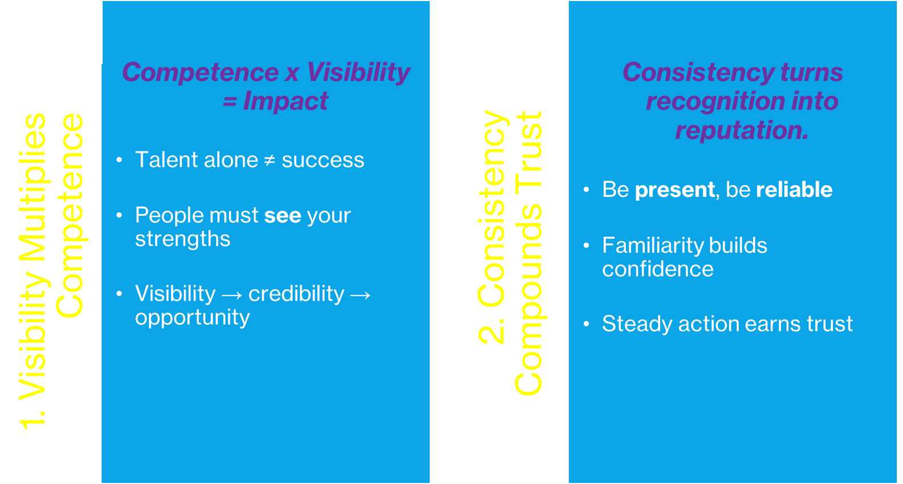
key takeaways
personal branding
Notes:
Your visibility attracts attention. Your consistency sustains it. Together, they transform competence into influence.
1. Visibility Multiplies Competence: Talent alone isn’t enough – people must see your strengths to value them. Visibility amplifies your credibility and career opportunities.
The most skilled professionals are often overlooked simply because they remain unseen.
2. Consistency compounds trust: Repeated, reliable presence builds familiarity and confidence. Posting, sharing, or contributing regularly shapes how others perceive your reliability.
Trust grows when people can predict your quality and presence.

Slide 8

Workbook Time: Your Visibility Audit Starts Here
Where do opportunities currently find you?
What do people already trust you for?
Where are you still unseen?
personal branding
Notes:
“Here’s your next step: open your Brand Playbook Worksheet – Section 1: Current Brand Baseline. Write down where opportunities currently find you, what people already trust you for, and where you’re still unseen. Be honest — this is your visibility diagnostic. Because awareness is the first step to growth. When you finish, move on to Lesson 2 — Positioning Yourself Like a Product. That’s where we turn visibility into clarity.”

Slide 9
Q&A
Feel Free To Ask
personal branding

Slide 10

Thank You
personal branding

