Slide 1







Personal Brand Accelerator
Course Wrap-Up: Your Personal Brand Accelerator Journey
From Clarity to Credibility
Notes:
“You started this journey with ambition, skill, and curiosity. And now, eight lessons later, you hold something far more powerful — clarity. Clarity about who you are, what you stand for, and how you show that to the world. This is the difference between drifting through a career and designing one.”

Slide 2

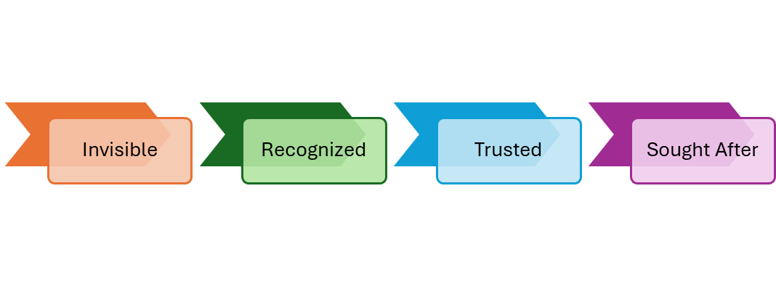

Transformation Recap
Goal
Notes:
“Over the past few hours, you’ve built your Personal Brand Playbook — not just a set of exercises, but a mirror for your professional growth. You’ve learned how visibility multiplies competence, how positioning turns confusion into clarity, how stories build trust, and how authority creates opportunity. You’ve learned that your personal brand is not a performance — it’s a promise you consistently keep.”

Slide 3
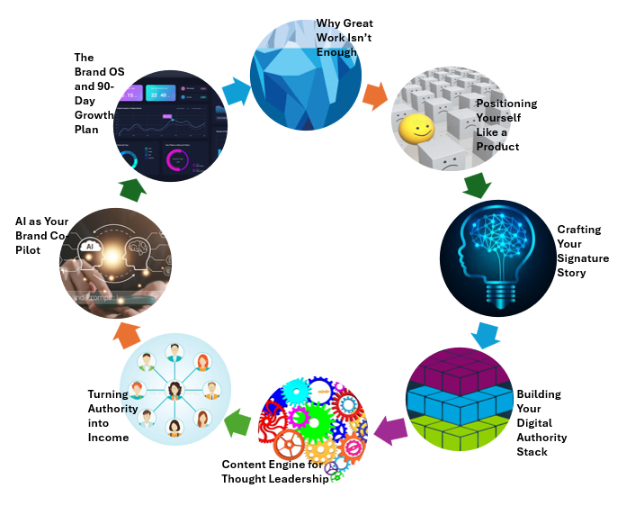
Lessons Summary Wheel

Slide 4


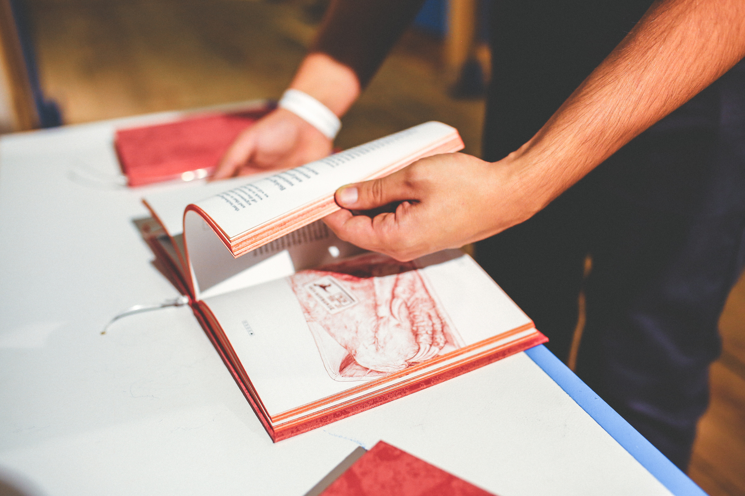
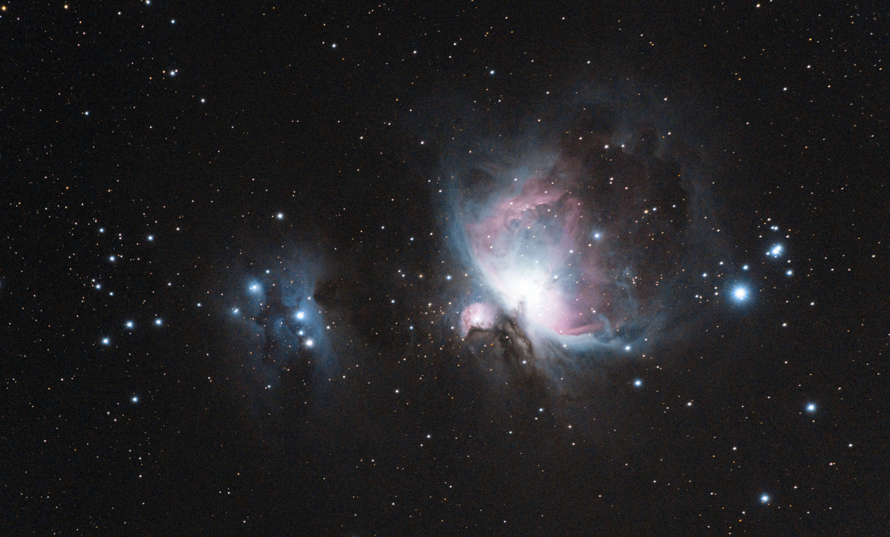
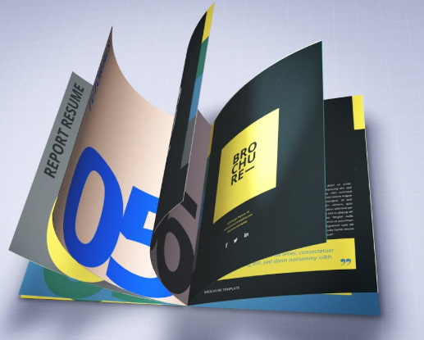
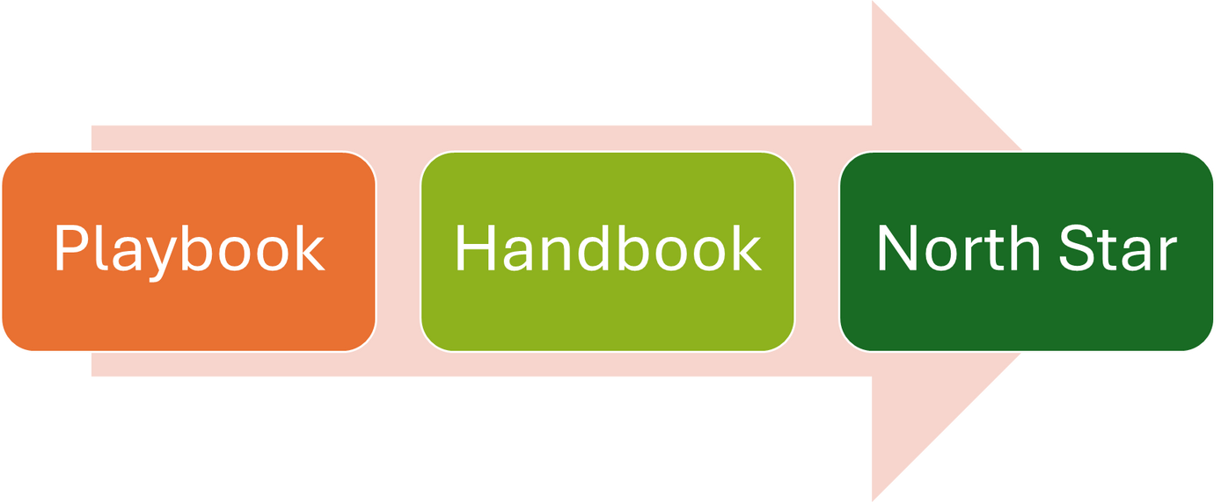
The Living System
Your living document for growth.”
Notes:
“Remember — your brand isn’t a one-time project. It’s a living system. The Brand OS you created will evolve with you. Each time you gain experience, face a new challenge, or pivot careers, your Playbook evolves. It’s your feedback engine, your reflection tool, your professional GPS. When used regularly, it doesn’t just guide your brand — it guides your decisions.”
“What you’ve built — your Brand Playbook — is now your Personal Brand Handbook. It’s your North Star — a living, breathing document that holds your story, your systems, and your strategy. Revisit it every 90 days. Refine your positioning, update your story, and realign your goals. The professionals who win aren’t the ones who never change — they’re the ones who adapt with intention.”

Slide 5


Who are you becoming through your work?
Reflection
Notes:
“As you step forward, remember this: your work deserves to be seen. Your expertise deserves recognition. And your story — the one you’ve crafted here — has the power to inspire, lead, and create real impact. You’re not waiting for opportunity anymore. You’ve built the system to attract it.”

Slide 6


Refine. Share. Review every 90 days.
Checklist

Slide 7


Call To Action
“You are your brand’s best story.”
Notes:
“Take a moment right now to review your Brand Handbook — your complete Playbook. Choose one section to act on this week. Maybe it’s refining your LinkedIn headline, publishing your first story, or reaching out to a mentor. Then schedule your 90-day review — a date with your future self. Because this isn’t the end of a course — it’s the start of your lifelong brand journey.”

Slide 8
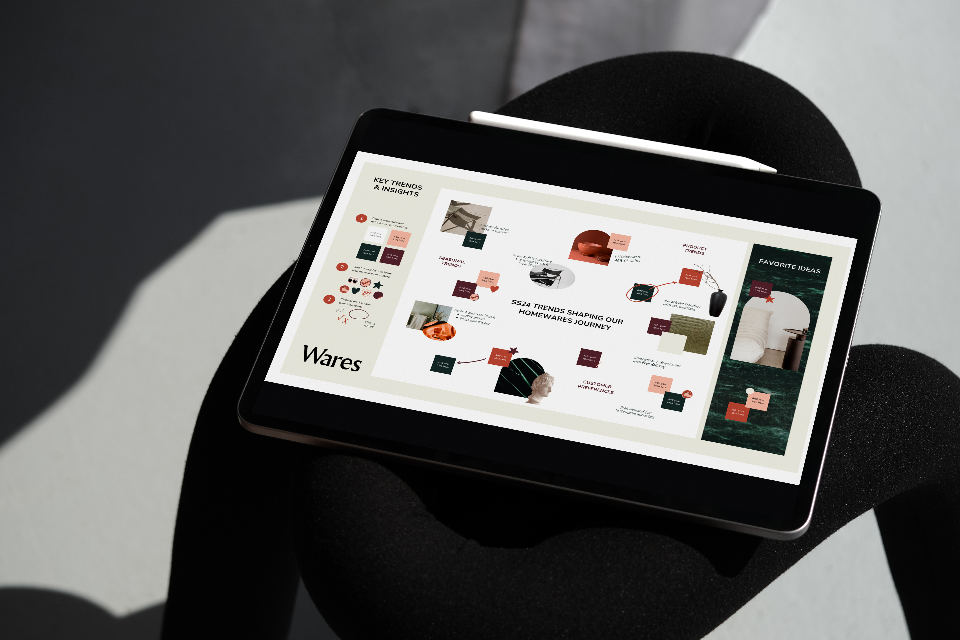
Thank You
“Keep building. Keep leading. Keep shining.”

